Slide 1
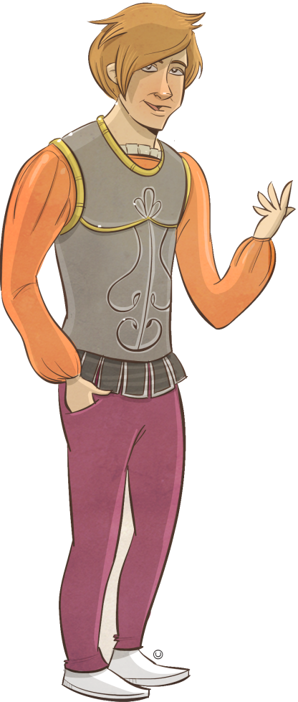
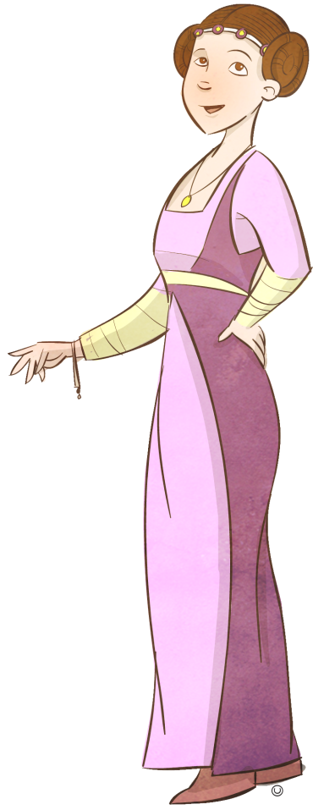
Character relationships map
The relationships map is a summary document that:
provides a brief description of each character
explains the nature of the connected characters’ relationship
explains the actions of characters towards each other
shows how the direction of arrows affects the relationships.

Slide 2
Romeo and Juliet: Character relationships map
Montague
enemies from feuding houses
Capulet
Prince decrees that further violence between the Capulets and Montagues will be met with penalty of death.
Prince Escalus
Lady Montague
Prince of Verona; establishes law and order
Lady Capulet
Rosaline
Romeo
Juliet
Paris
The Nurse
Benvolio
Activity description
Explain the nature of the connected characters’ relationship.
Explain how a character undertakes a significant action towards another character.
Balthasar
Friar Laurence
Apothecary
Friar John
Mercutio
Tybalt

